Slide 1
Program
MineOperate Technical Level 1
OP Pro Simulator TL1
Edgar Sepulveda
Global Technical Manager, MineOperate
10/10/2022
Version 1.3

Slide 2

Purpose
This session introduces JAMSSimulator which is usually used to troubleshoot the MineOperate OP Pro systems.
​At the end of this module, you will:
be able to run JAMSSimulator for JSPanel and OP Pro Manager applications.​
Run Sensor Simulator​ for OP Pro.
Run simprompt to simulate OEM interfaces.

Slide 3
OP Pro Simulator
JAMSSimulator is a service provide by OP Pro which help us to run OP Pro field equipment and office applications in a test environment. Running simpromt script together JAMSSimulator, we can send simulate OEM interface values to applications open by JAMSSimulator.
JAMSSimulator is used by Service & Support personnel for system testing before deployment to the live environment, Software upgrades, new hardware and try to replicate issue reported by clients.
Simulator Limitations
Limited number of hardware connections.
Optimizer functions are not simulated.
Communications network is not same as real world.

Slide 4
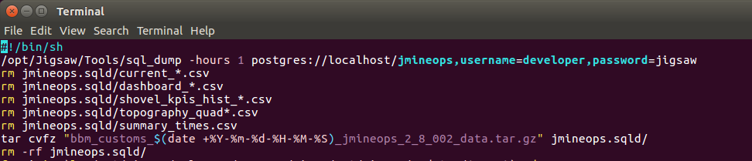
OP Pro Simulator
Getting an OP Pro backup database
bbm03:~$ /opt/Jigsaw/Tools/sql_dump -hours 1 postgres://localhost/jmineops,username=UserName,password=Password

Slide 5
OP Pro Simulator
Restoring an OP Pro backup database
hxgn:~$ dropdb -U developer jmineops_bbm
hxgn:~$ createdb -U developer jmineops_bbm
hxgn:~$ psql -U developer jmineops_bbm -c "CREATE EXTENSION psqlprocs;“
hxgn:~$ /opt/Jigsaw/Tools/sql_load jmineops.sqld/ postgres://localhost/jmineops_bbm,username=UserName,password=Password
hxgn:~$ /opt/Jigsaw/Tools/xml_loader -database jmineops_bbm /opt/Jigsaw/Library/jmineops/db/PostgreSQL/gps_points.sql
hxgn:~$ /opt/Jigsaw/Tools/xml_loader -database jmineops_bbm views

Slide 6
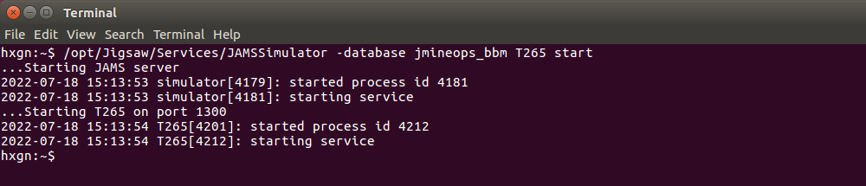
OP Pro Simulator
Running JAMMSimulator
hxgn:~$ /opt/Jigsaw/Services/JAMSSimulator -database jmineops_bbm T265 start

Slide 7
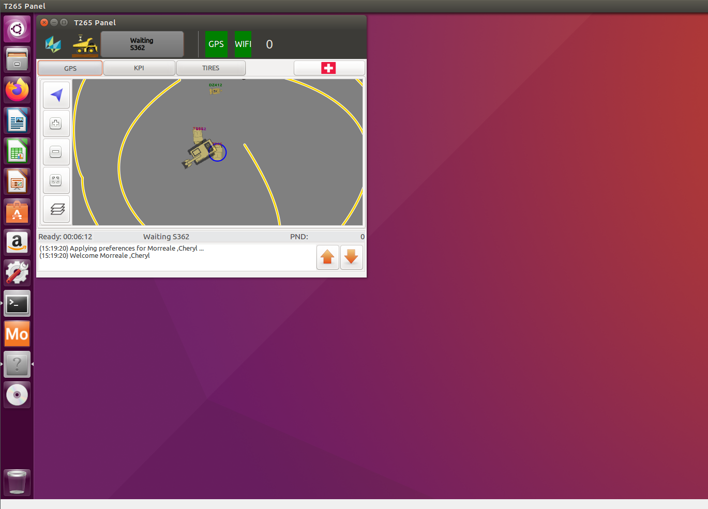
OP Pro Simulator
Running JAMMSimulator

Slide 8
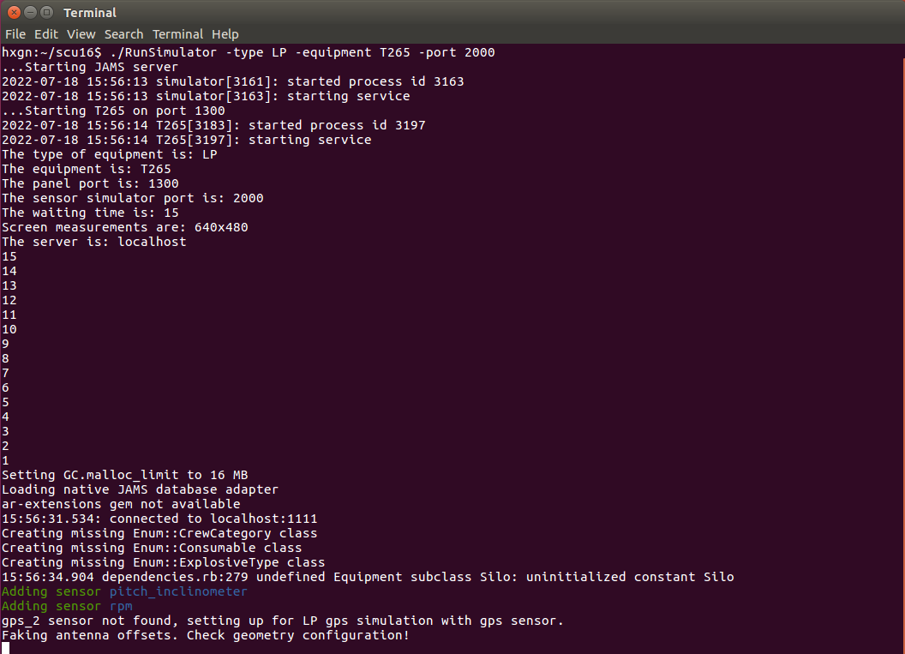
OP Pro Simulator
Running ./RunSimulator script
hxgn:~/scu16$ ./RunSimulator -type LP -equipment T265 -port 2000

Slide 9
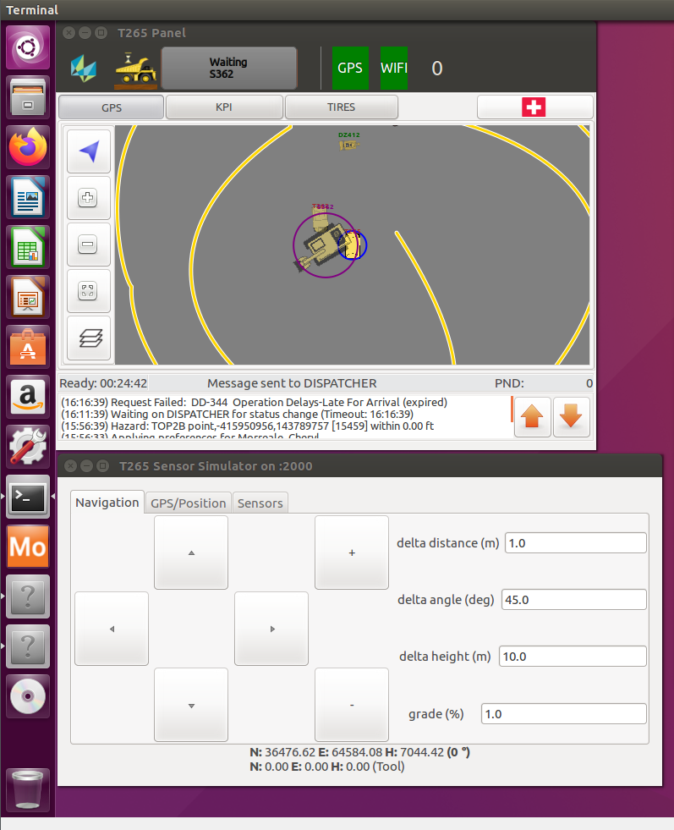
OP Pro Simulator
Running ./RunSimulator script

Slide 10
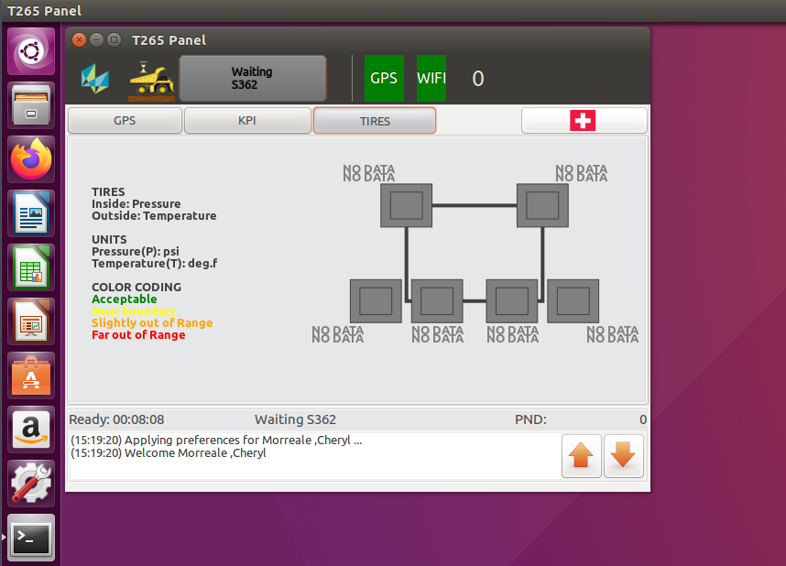
OP Pro Simulator
Running simprompt

Slide 11
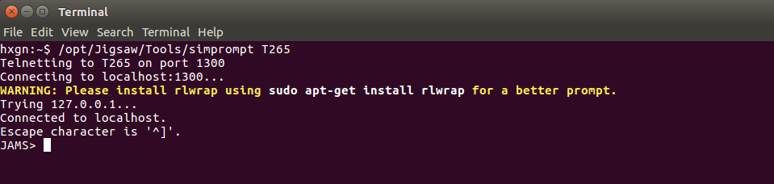
OP Pro Simulator
Running simprompt
hxgn:~$ /opt/Jigsaw/Tools/simprompt T265

Slide 12
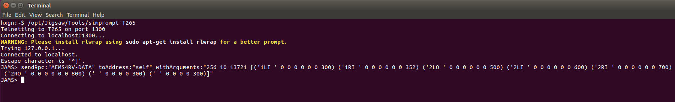
OP Pro Simulator
Running simprompt
JAMS> sendRpc:"MEMS4RV-DATA" toAddress:"self" withArguments:"256 10 13721 [('1LI ' 0 0 0 0 0 0 300) ('1RI ' 0 0 0 0 0 0 352) ('2LO ' 0 0 0 0 0 0 500) ('2LI ' 0 0 0 0 0 0 600) ('2RI ' 0 0 0 0 0 0 700) ('2RO ' 0 0 0 0 0 0 800) (' ' 0 0 0 0 300) (' ' 0 0 0 0 300)]"

Slide 13
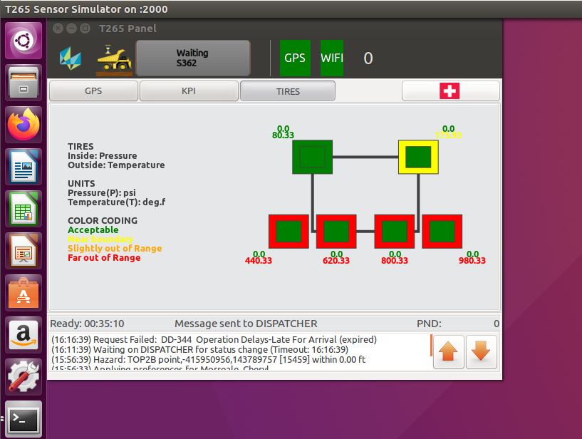
OP Pro Simulator
Running simprompt

Slide 14
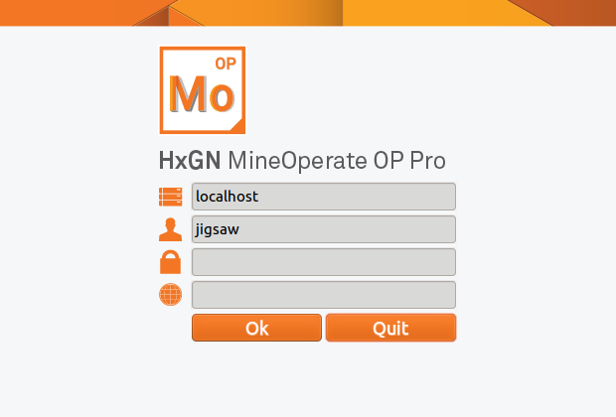
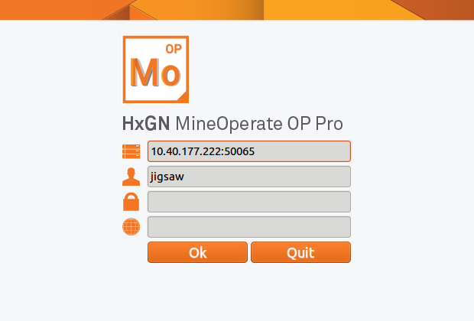
OP Pro Simulator
Running OPProManager.rb ruby application
hxgn:~$ vi /opt/Jigsaw/Services/config.jams
hxgn:~$ /opt/Jigsaw/Services/JAMSRouter start
hxgn:~$ ruby /opt/Jigsaw/Library/ruby/OPProManager.rb

Slide 15
Simulator - Questions
True or False JAMSSimulator is a service provide by OP Pro which help us to run OP Pro field equipment and office applications in a test environment.
True or False Running simpromt script together JAMSSimulator, we can send simulate GPS coordinates to applications open by JAMSSimulator.
What are some activities that Service & Support teams can use OP Pro Simulator?
System testing before deployment to the live environment.
Software upgrades.
Test new hardware.
Try to replicate issue reported by clients.
All above.
True or False sql_dump and sql_load are OP Pro tools used to get a new OP Pro backup database.
True or False We can run OPProManager.rb ruby file to simulate OP Pro Manager application and connect to a local and remote server.

Slide 16
Simulator - Answers to Questions
True or False JAMSSimulator is a service provide by OP Pro which help us to run OP Pro field equipment and office applications in a test environment. True
True or False Running simpromt script together JAMSSimulator, we can send simulate GPS coordinates to applications open by JAMSSimulator. False
What are some activities that Service & Support teams can use OP Pro Simulator?
System testing before deployment to the live environment.
Software upgrades.
Test new hardware.
Try to replicate issue reported by clients.
All above.
True or False sql_dump and sql_load are OP Pro tools used to get a new OP Pro backup database. True
True or False We can run OPProManager.rb ruby file to simulate OP Pro Manager application and connect to a local and remote server. True

Slide 17

THANK
Y
O
U

